Slide 1

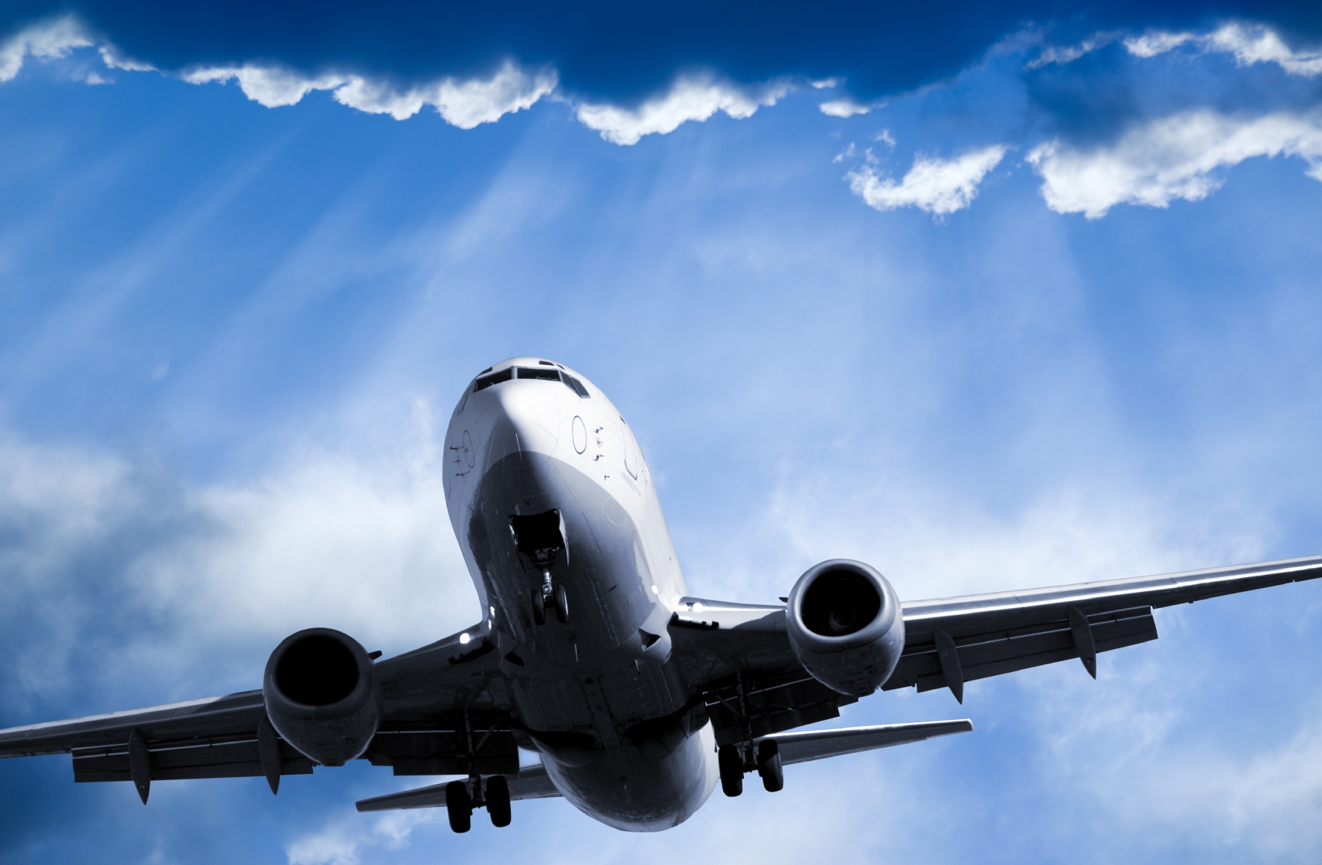
Natural Language Processing in Text Classification for Standard Operating Procedures in the Airline Industry
Team Chargers
DEAN 690
Fall 2022
Notes:
This Photo by Unknownauthor is licensed under CC BY-SA-NC.

Slide 2



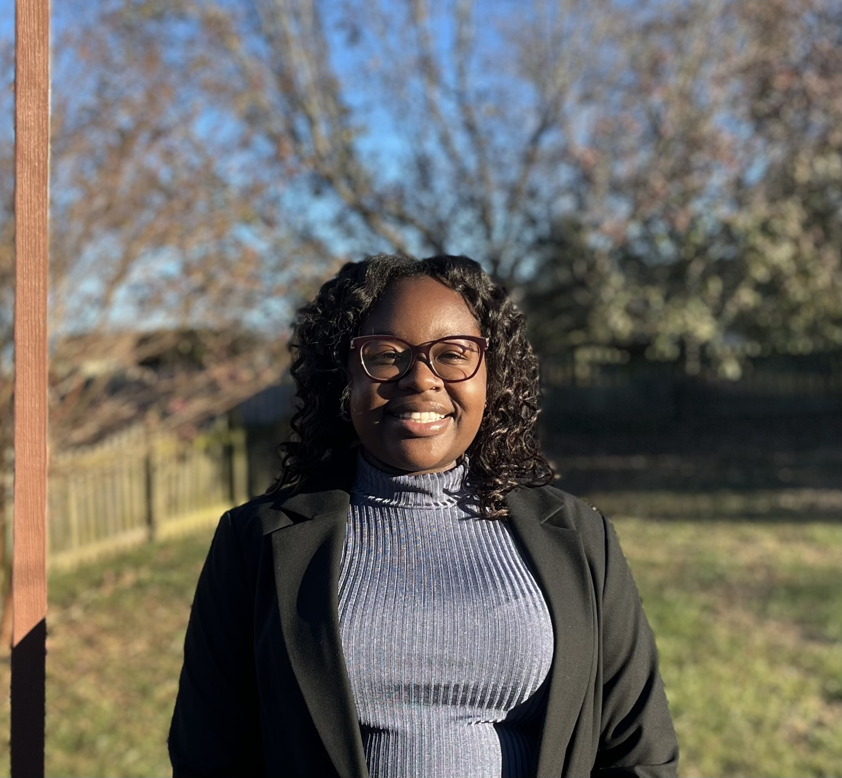
Team Chargers
Beakal Abera
Tiarrah A Bayne
Esteban Echandi
Jeanie Bailey
1

Slide 3

Partners
Professor F. Bret Berlin
F. Brett Berlin's passion for new value creation is built on over 50 years of professional experience innovating and advocating for innovators applying leading edge information solutions to mission challenges.
Dr. Lance Sherry
Lance Sherry is an Associate Professor in the Systems Engineering and Operations Research department and serves as Director of the Center for Air Transportation Systems Research at the College of Engineering and Computing at George Mason University.
Jomana Bashatah
PHD candidate in Department of Systems Engineering and Operations Research with publications in analysis of models of standard operating procedures.
7

Slide 4
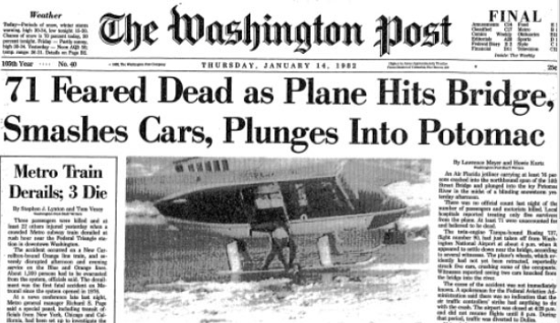
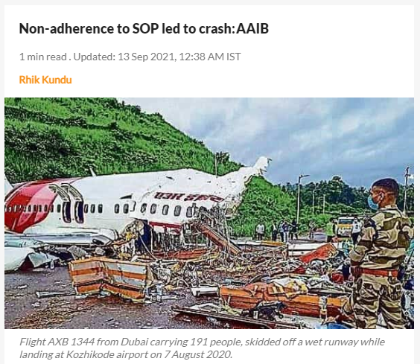
Problem Statement
Extract useful information from SOPs, this research will help to:
Reduce potential costs
Improve training
Increase safety and reduce human error
4
Notes:
Standard Operating procedures (SOPs) are documented step-by-step instructions followed by human operators which are essential to perform critical, repetitive, complex, and emergency-related tasks as efficiently as possible. Due to these aspects and since SOPs play a significant role in any type of process, it is critical to find a systematic method to quantify their information. Nowadays SOPs are created manually by a subject matter expert in the field, which is time-consuming and a tedious process to follow. In addition to this, these documented instructions usually are in formats that are difficult to systematically extract any type of data from. The challenge of the project will be to extract useful statistical information from SOPs to help future research on their automation. When this has been created, it has the potential to reduce costs, improve training, and most importantly, increase safety and reduce human error.
Air florida flight 90 (flight crew failure to enforce a sterile cockpit during the final preflight check list procedure
Air india express (august 2020) the non adherence to the sop lead to a fatal crash – the pilot fialed to properly take over controls and instead executed a "go round" that in turn resulted in the casutalties

Slide 5
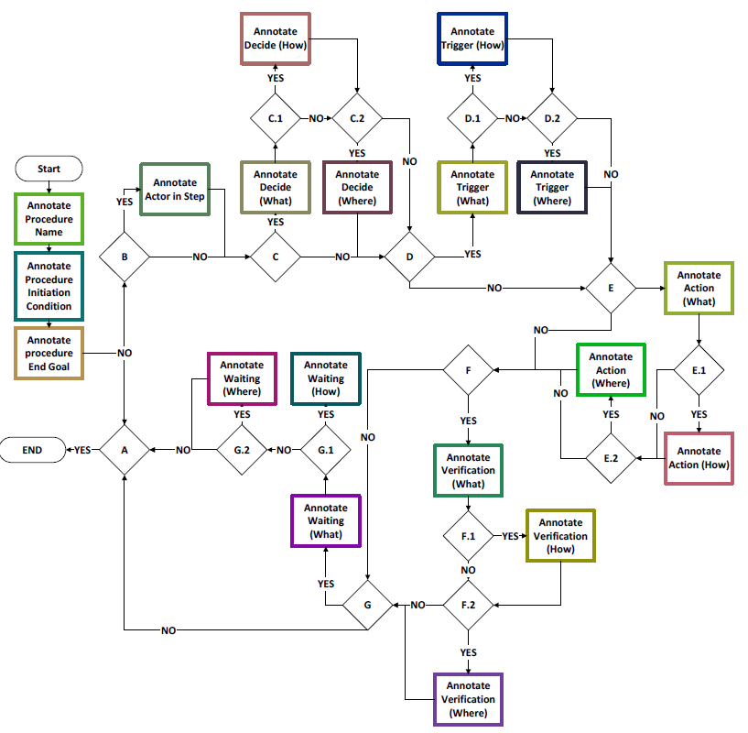
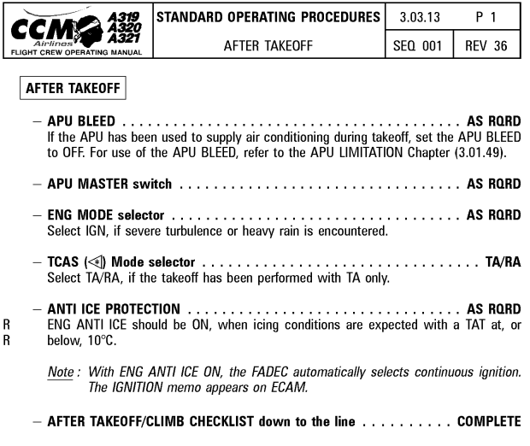
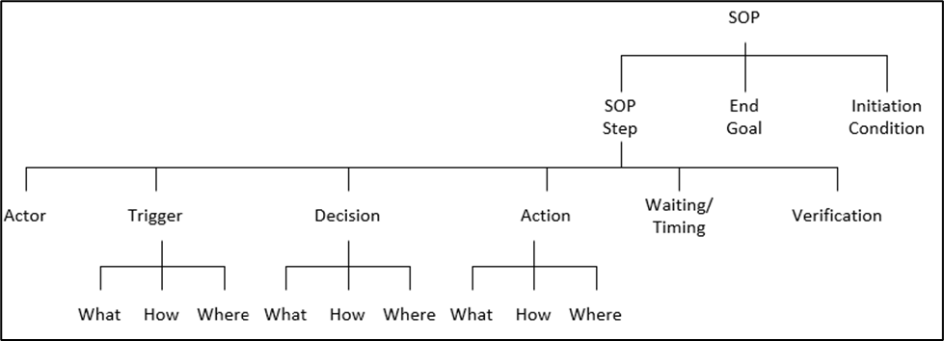
Align on labels
7

Slide 6
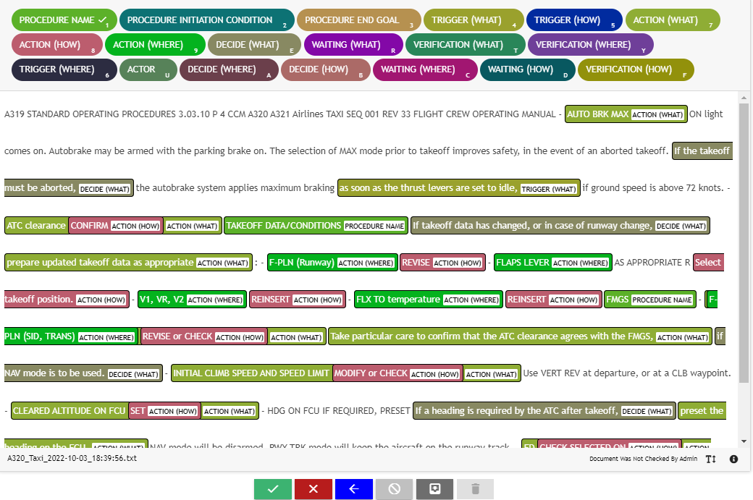
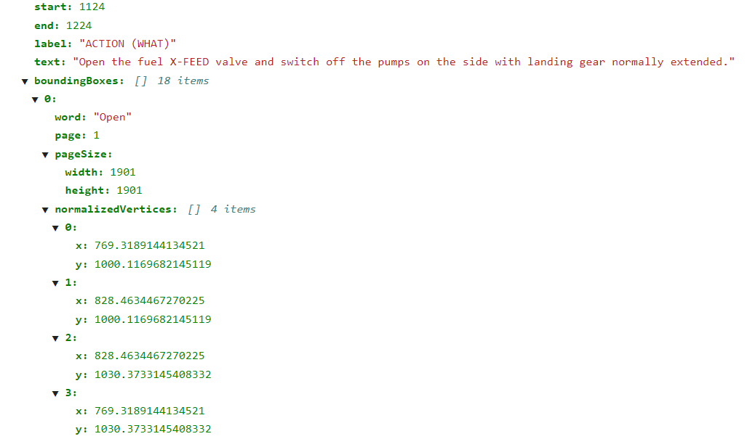
UBIAI for annotating SOPs
7

Slide 7
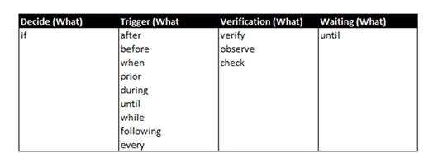
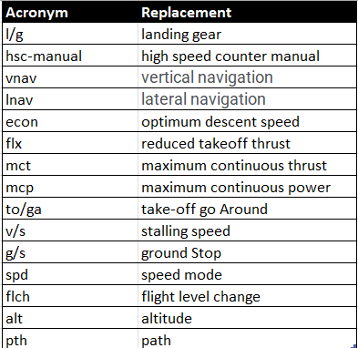
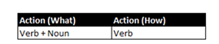
Data Cleaning
2. Deterministic Rules
Acronym Replacement
3. Parts of Speech Tagging
7

Slide 8
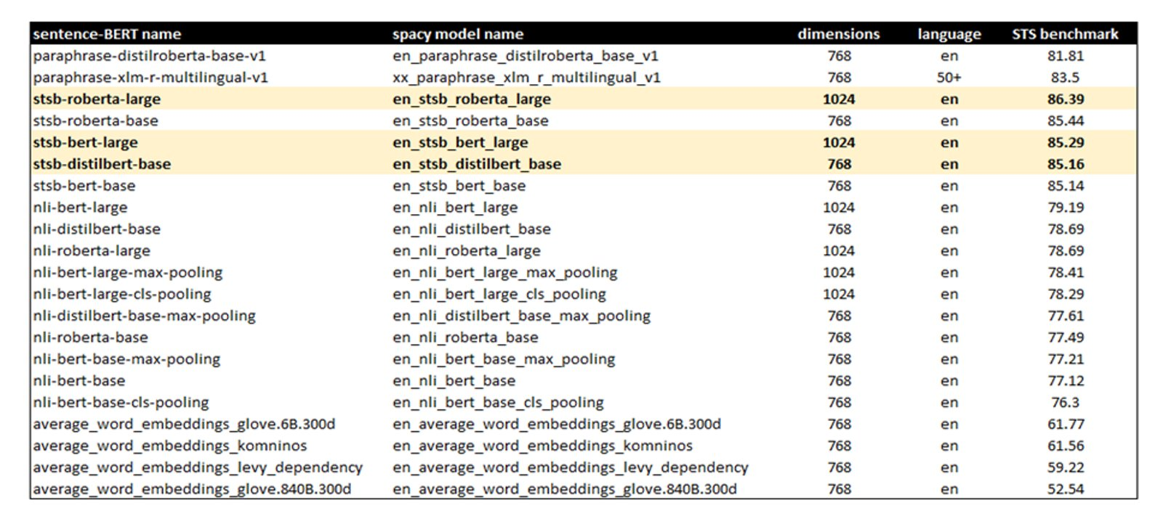
Bidirectional Encoder Representations from Transformers (BERT)
Bidirectional transformer
Roberta-large
Bert-large
DistilBERT-base
BERT
Preprocess
Encoding
8

Slide 9
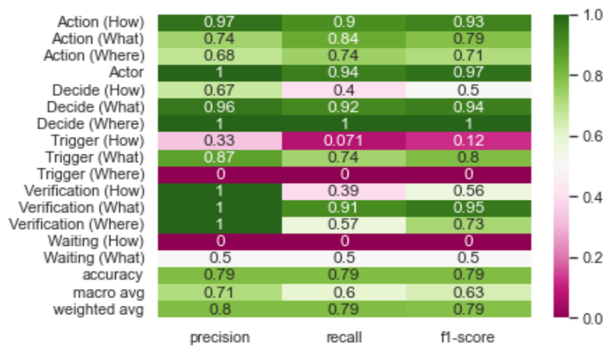
Classifiers
Support Vector
Random Forest
Decision Tree
XGBoost
Stochastic gradient descent
9

Slide 10
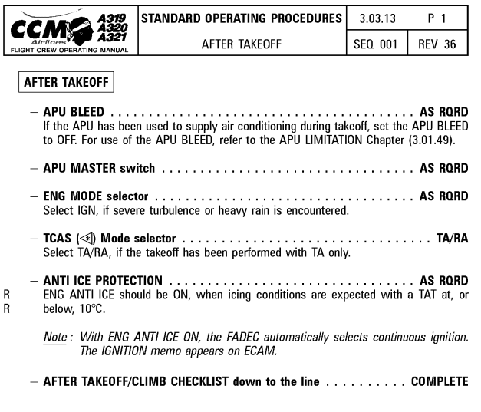
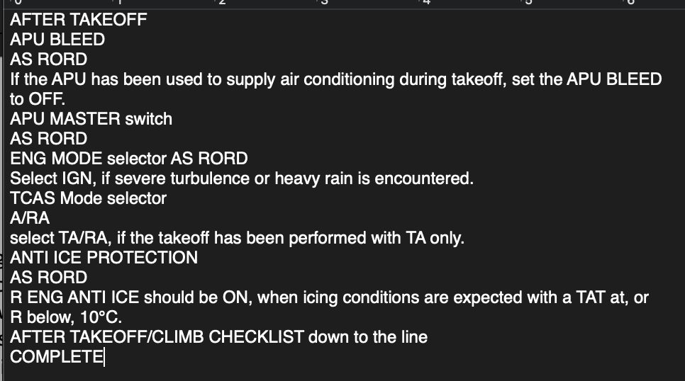
PDF conversion
10

Slide 11
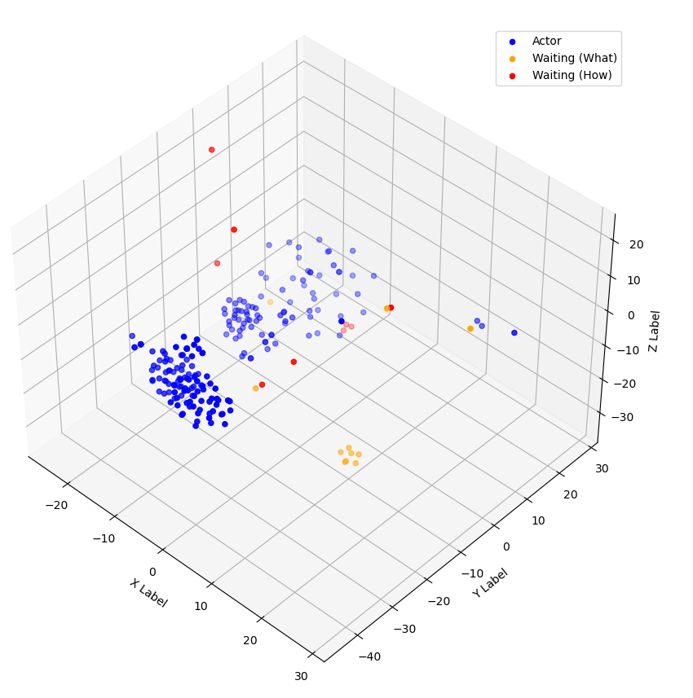
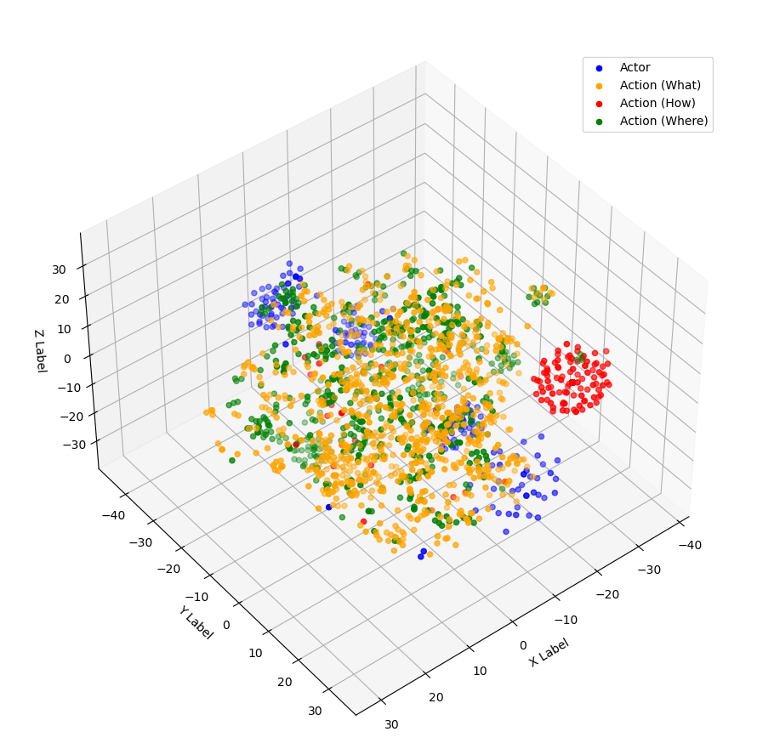
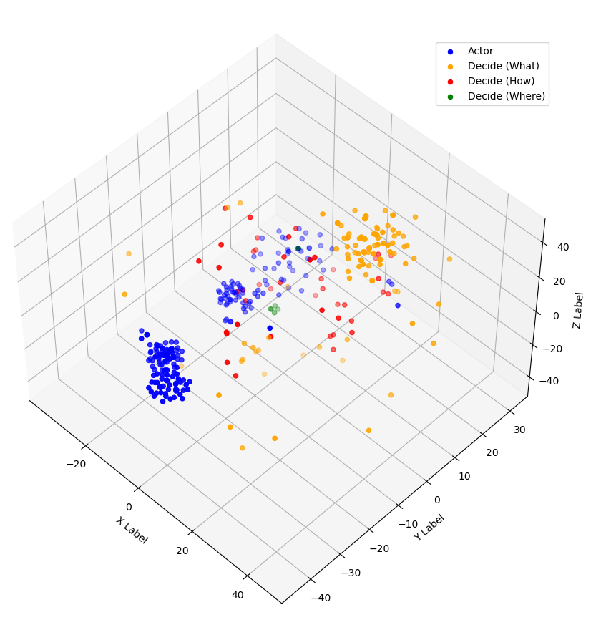
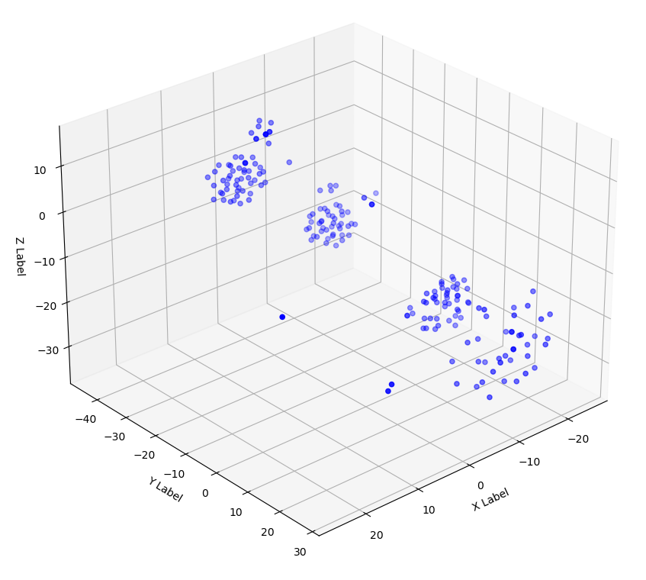
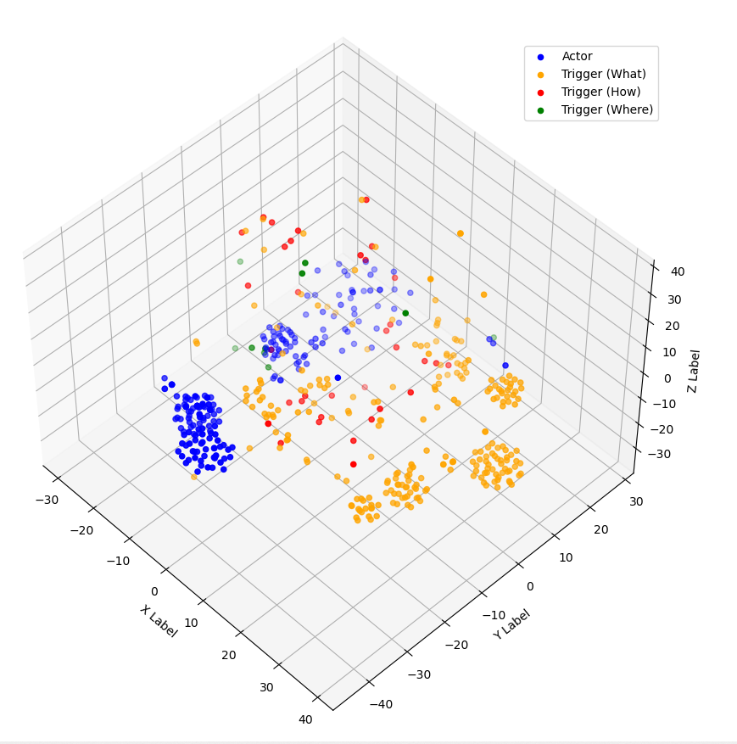
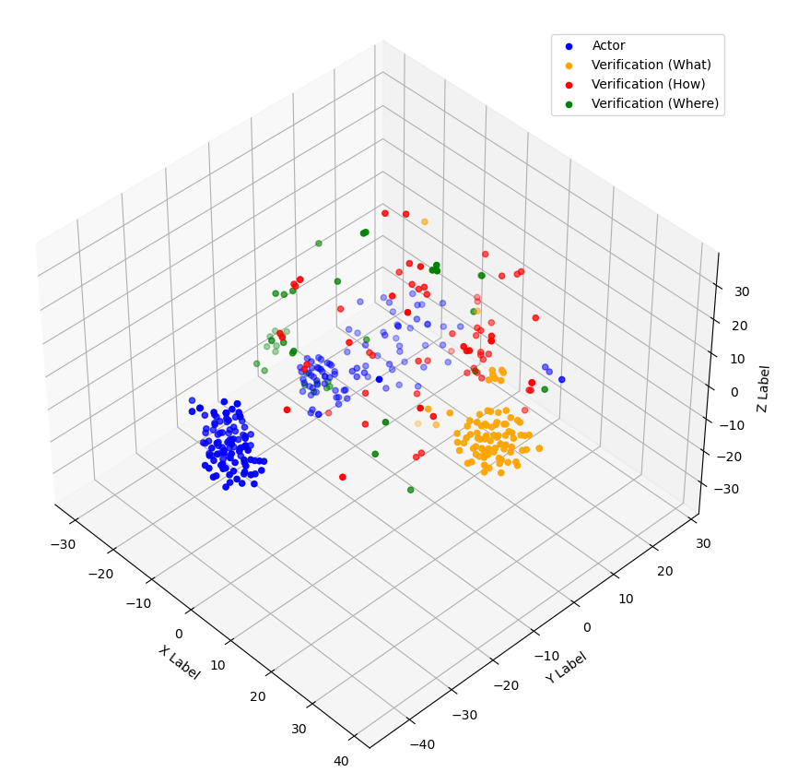
Visualization/ Machine Learning Model
Actor
Actor
Actor
Action
Action
Action
Trigger
Trigger
Trigger
Decide
Decide
Decide
Verification
Verification
Verification
Waiting
Waiting
11

Slide 12
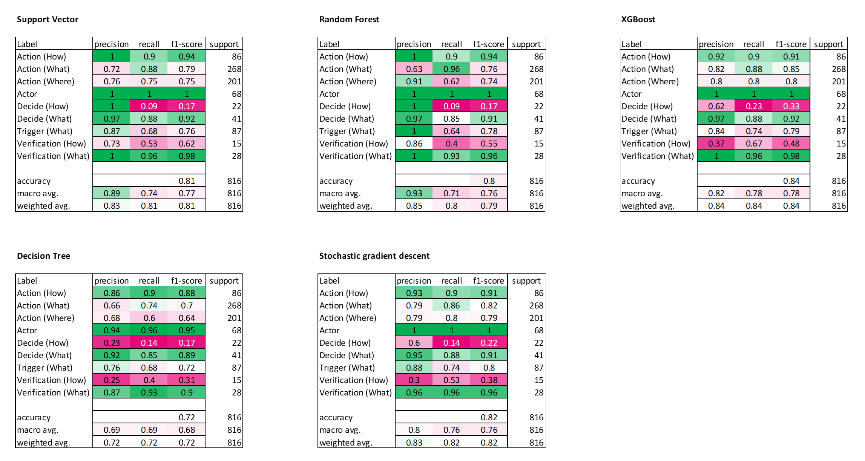


Visualization/ Machine Learning Model
12

Slide 13
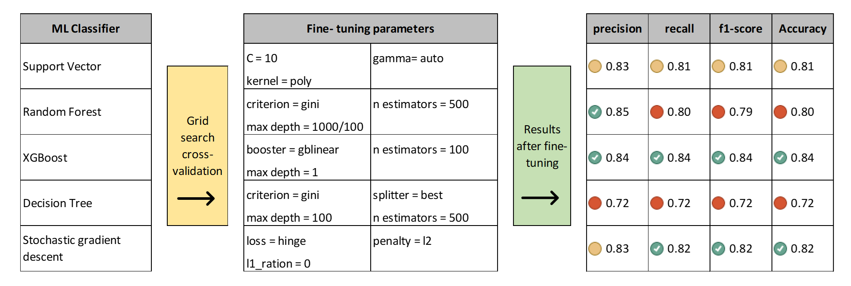

Visualization/ Machine Learning Model
13

Slide 14
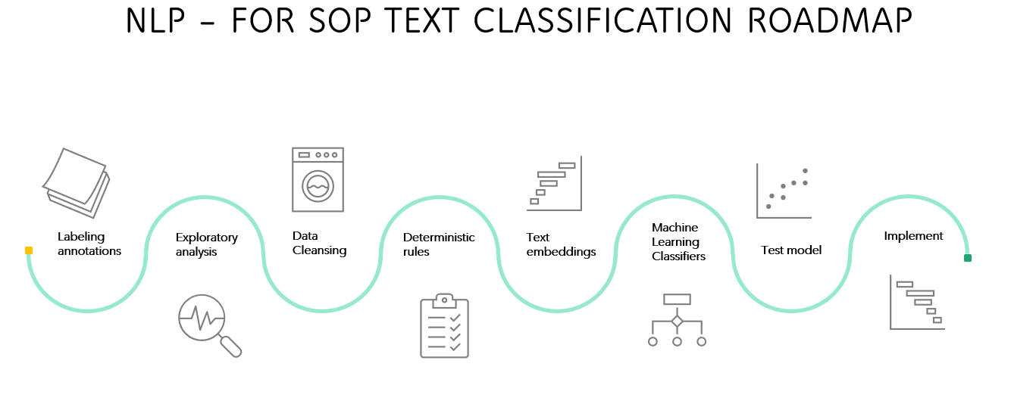
Summary – NLP for SOPs in a Nutshell
14
Notes:
Before the model could be created, had to annoate the sop. This was done using ubiai to convert pdf to json files to exel. Then the data was cleaned for the nlp model. After the vector was created and could analyze the data and

Slide 15
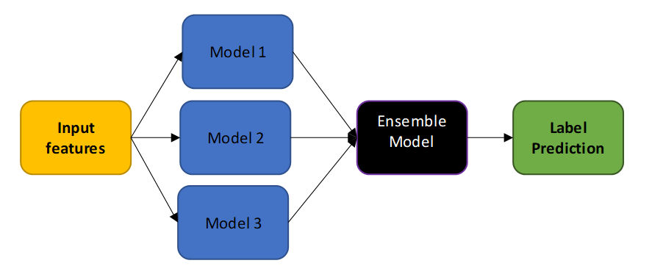
Next Steps or Recommendations
Start
Additional annotation for sequence analysis.
Simulated dataset to mitigate label scarcity.
Ensemble modeling
End
Preposition of time + Unit of time [ secs., mins., or hrs.]
15

Slide 16

Questions?

